Slide 1


Zomato Ratings Prediction Bangalore City
GROUP 5:
Jidnyasa Heda (20)
Ruchika Dhamane (41)
Shivani Bihade (49)
Vishal Malpure (58)

Slide 2
Why this Data?
Bangalore is the capital and largest city of the Indian State of Karnataka.
With a population of over 15 million , Bangalore is the third largest city in India and 27th largest city in the world.
It is also referred to as the “Silicon Valley of India” .
Bangalore has a unique food culture wherein restaurants from all over the world can be found here in Bangalore with 12000 plus restaurants currently active in the city, the number is still increasing.
The basic idea behind analyzing the Zomato dataset is to get a fair idea about the factors affecting the aggregate rating of each restaurant.

Slide 3

About the Dataset
The data set is taken from Kaggle and contains the following 17 variables:
1
url : This feature contains the url of the restaurant on the Zomato website
2
name : This feature contains the name of the restaurant
3
online_order : whether online ordering is available in the restaurant or not
4
book_table : table book option available or not
5
rate : contains the overall rating of the restaurant out of 5
6
votes : contains total number of upvotes for the restaurant
7
phone : contains the phone number of the restaurant
8
location : contains the neighborhood in which the restaurant is located
9
cuisines : food styles, separated by comma

Slide 4
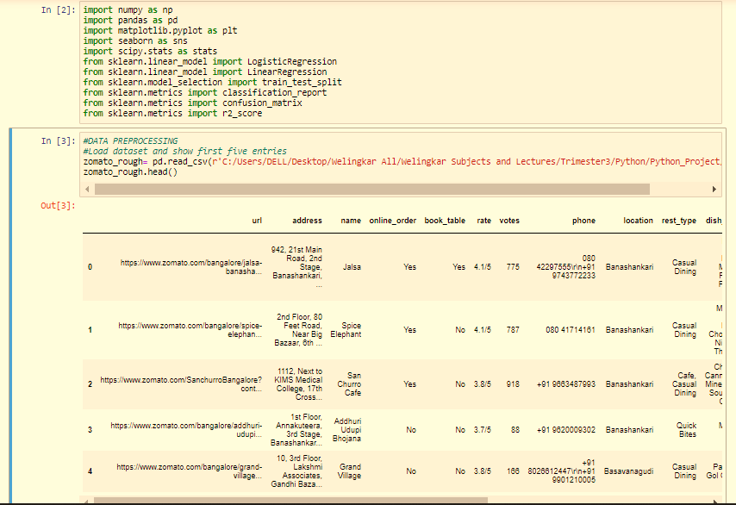
Data Preprocessing
Step 1: Importing required libraries like NumPy ,pandas, matplotlib, SciPy, sklearn
Step 2: Loading the dataset and displaying first five entries.

Slide 5
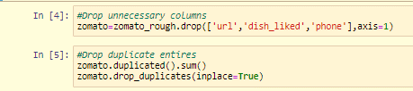
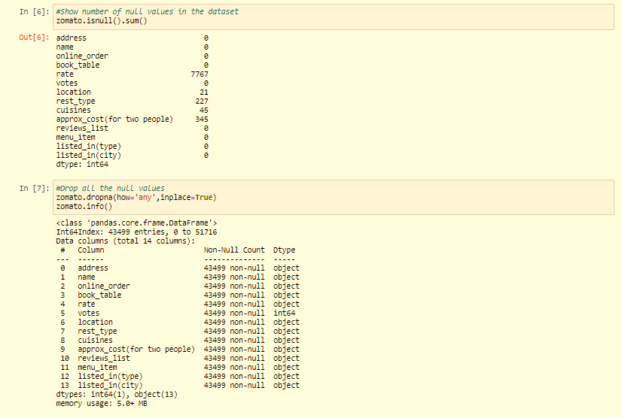
Data Preprocessing
Step 4: Deleting the unnecessary columns which do not have any effect on the food ratings given by the customers.
Step 5: Finding out the no. of null values and deleting them in order to reduce the redundancy while model building.

Slide 6
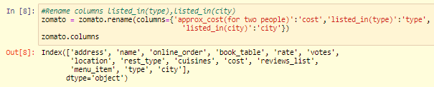
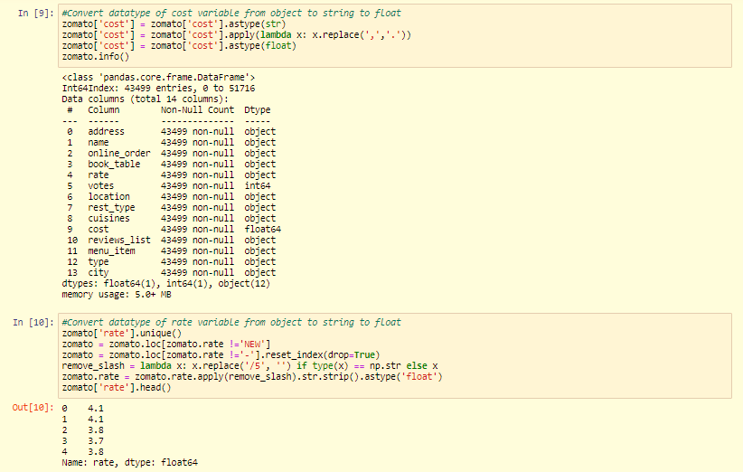
Data Preprocessing
Step 6: Renaming the selected variables.
Step 7: Converting the datatype of variables in the required datatype..

Slide 7
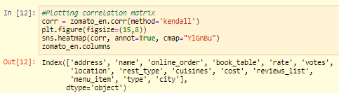
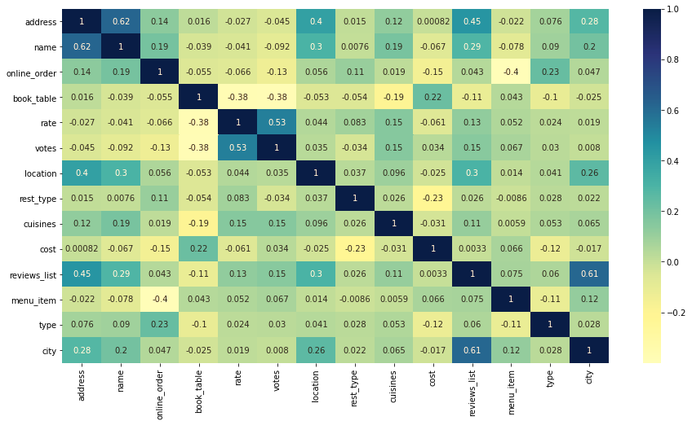
Exploratory Data Analysis
Correlation Matrix:
It displays the correlation between the variables.
Values above+0.7 depicts high positive correlation.
These higher correlation are highlighted in dark colors.

Slide 8
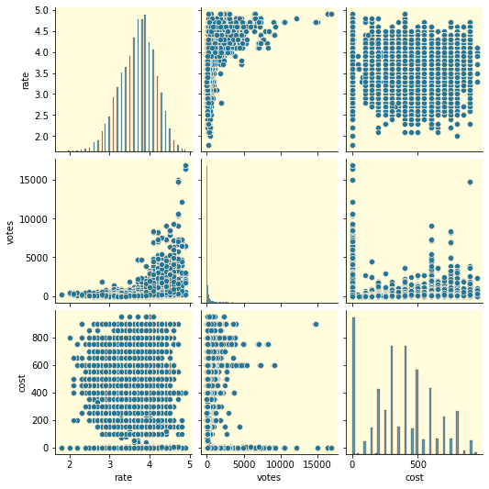
Exploratory Data Analysis
Pair Plot:
It displays a pairwise relationships in the dataset.
It is used to understand the best set of features to explain a relationship between two variables .
The main-diagonal subplots are the univariate histograms for each attribute.
The other figure shows bivariate distributions .

Slide 9
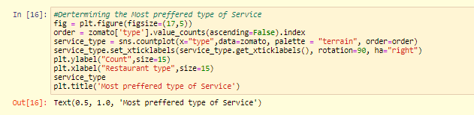

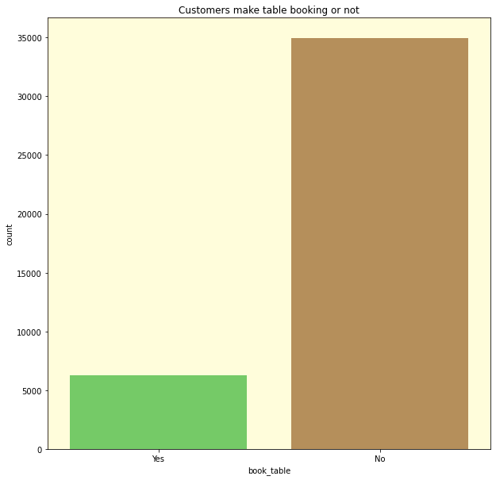
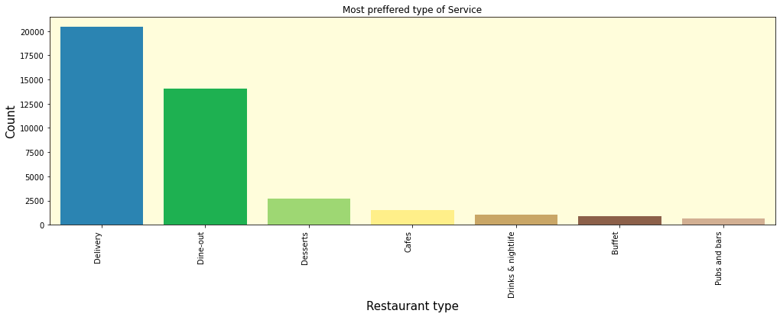
Exploratory Data Analysis
Plotting and Visualizing various features

Slide 10
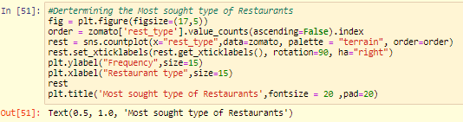
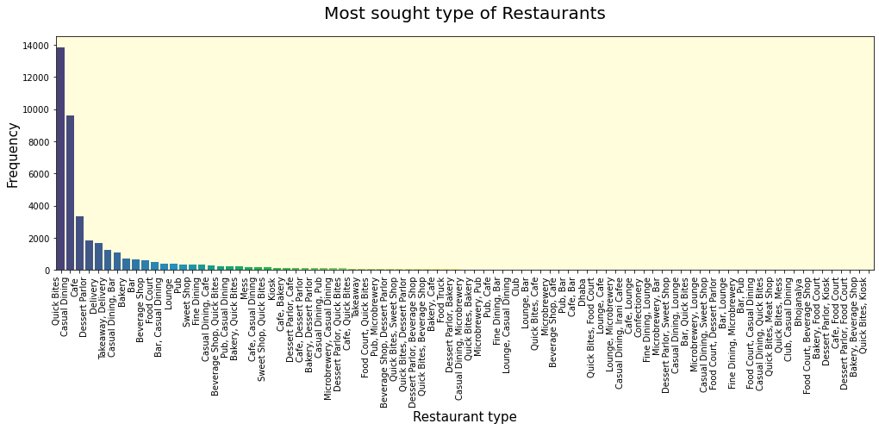
Exploratory Data Analysis
Determining the most sought restaurants by the customers based on data.
Determining the most sought restaurants by the customers with the help of count plot.

Slide 11
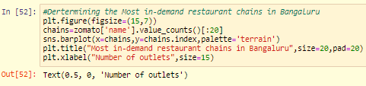
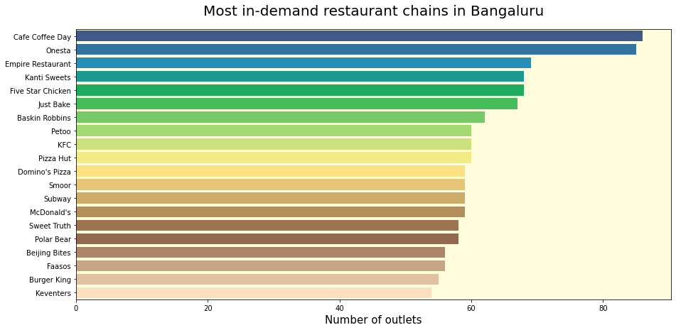
Exploratory Data Analysis
Determining the most in-demand restaurants chains in Bangalore based on data.
Determining the most in-demand restaurants chains in Bangalore based on data using bar plot.

Slide 12
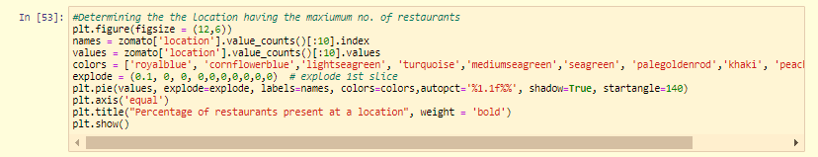
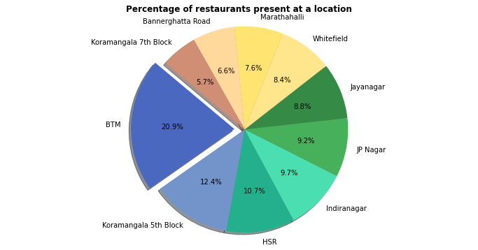
Exploratory Data Analysis
Determining the location with the maximum restaurants in Bangalore based on data.
Determining the location with the maximum restaurants in Bangalore based on data using a pie plot.

Slide 13
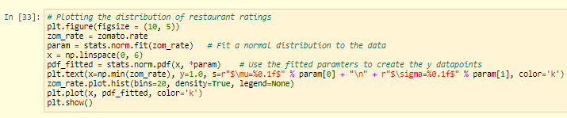
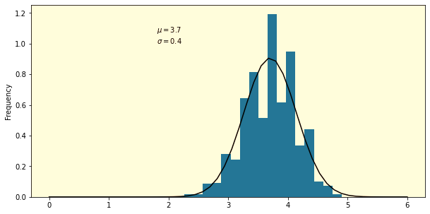
Model Building And Interpretation
Determining distribution of ratings based on data.
Determining distribution of ratings based on data using histogram.

Slide 14
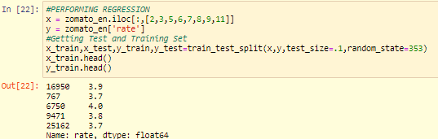
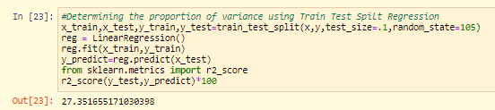
Model Building And Interpretation
Defining training and testing variables
Train Test Split Regression

Slide 15
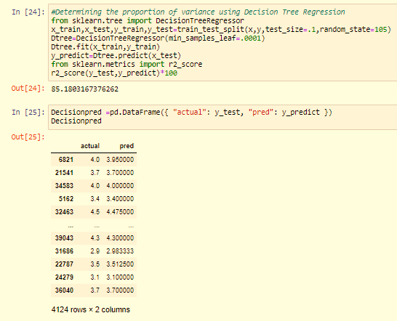
Model Building And Interpretation
Decision Tree Regression
Comparison of actual vs predicted values

Slide 16
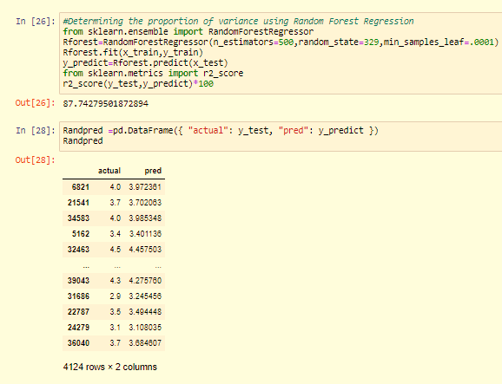
Model Building And Interpretation
Random Forest Regression
Comparison of actual vs predicted values

Slide 17

Model Building And Interpretation
Mean Absolute Percentage Error

Slide 18
Conclusion
Final model showed an improvement in R square to 87.74% after applying various models of regression.
The ratings curve is normally distributed.
Retraining approach : Needs generation of a pickle file after every month to increase the accuracy and R-Square value.
Business Implication
The model can be used by restaurants to help them make improvements based on the ratings.
The model will also help customer to get the best restaurant of their choice.

Slide 19
Reference Links
https://github.com/jidnyasaheda
https://github.com/ruchikadhamane
https://github.com/ShivaniBihade
https://github.com/VishalMalpure

Slide 20
Thank you!!!

